Slide 1
Information, Systems and Technology
CIS041-3 Advanced Information Technology
Gangmin Li
(Office hours: 13:00-17:00 every Friday)

Slide 2
Outline
What is Information?
Information systems
Information technology
Advanced information technology (2022)

Slide 3
What is Information?
1

Slide 4
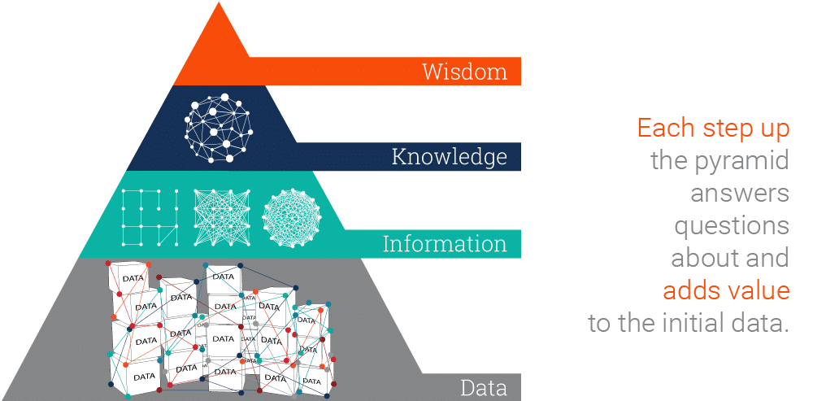
Data, Information, Knowledge, Wisdom (DIKW) Pyramid
The DIKW Pyramid represents the relationships between data, information, knowledge and wisdom..
Rowley, Jennifer (2007). "The wisdom hierarchy: representations of the DIKW hierarchy". Journal of Information and Communication Science. 33 (2): 163–180. doi:10.1177/0165551506070706. S2CID 17000089. https://www.wikiwand.com/en/DIKW_pyramid

Slide 5
Data
Data: Representation the raw facts and natural existence in a way helping human to understand the nature.
Raw data has no (or hard to get its) meaning!
Example:
12012012
What does it mean?
Formatting: 12/01/2012 – we added meaning!
Data ambiguous – 1st of December in the US, 12th of Jan in Europe
12th of Jan, 2012 would be 2012/01/12 in China

Slide 6
Data
Data usually is organised into structures such as tables that provide additional context and meaning
Data are represented in different types such as scientific data, finance data, cultural data.
Data is collected using techniques such as measurement, observation, query, or analysis, and typically represented as numbers or characters which may be further processed.

Slide 7
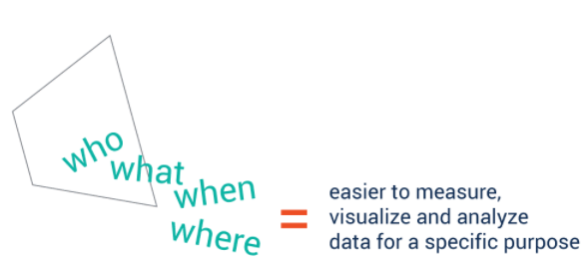

Information
Information is data that has been processed (cleaned/processed) to make it meaningful and useful (for special purposes).
For instance, from a list of marks (data) you could infer that girls did better than boys (information)
Good quality information should be
Accurate
Up-to-date
Relevant
Complete
On-time
Appropriately presented
Intelligible
Answering interrogative questions

Slide 8
Information
Is data that structured.
“organized or structured data, which has been processed in such a way that the information now has relevance for a specific purpose or context, and is therefore meaningful, valuable, useful and relevant.”
-- Rowley
Is data that subjective
"related to meaning or human intention", either as "the contents of databases, the web, etc.“
“the meaning of statements as they are intended by the speaker/writer and understood/misunderstood by the listener/reader.“
-- Hanne Albrechtsen

Slide 9
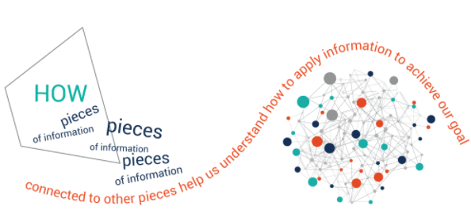

Knowledge
“Information in action” – the part of information that is applied to solve a problem.
Knowledge is not just a description of collected facts (information), but also understand how to apply it to achieve goals.
Knowledge is recipients' reflection or reaction of information being received

Slide 10
Knowledge
Processed information
"organization and processing to convey understanding, experience [and] accumulated learning"
"a mix of contextual information, values, experience and rules"
Contested information (in practice)
“know-how”, "know-who" and "know-when", each gained through "practical experience".
Propositional information (belief. Tacit knowledge, Explicit knowledge)

Slide 11
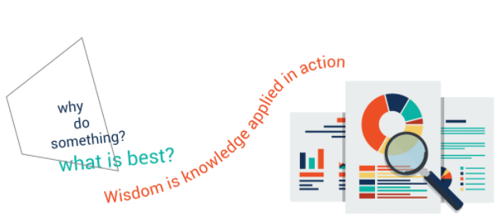
Wisdom
Wisdom is knowledge applied in action.
We must answer questions such as ‘why do something’ and ‘what is best’.
After so many actions the knowledge left stand the test.

Slide 12
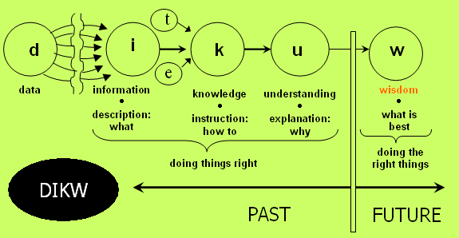
A flow diagram of the DIKW

Slide 13
Thinking
Read the reading materials about DIKW and discuss your understanding using examples to describe data, information, knowledge and wisdom. Particularly, explain the context, culture and religion's role in knowledge and wisdom.
Example:
A house wife (have 5 kids) heard that the oil price at Nasdaq is 98 pence per litre today, the next day, she go to a patrol station to fill her tank. Explain what is the data and what is information, knowledge and wisdom in this situation?

Slide 14
Today’s society: data or info?
“is information dependent” (Christie 1985 / Zuboff 1988 / G7 1995)
“creates and demands more information” (Marchionini 1995)
“Information Society”
DATA is considered as one of the most important resources in all organizations
How could we:
Process sales of goods?
Decide what to buy?

Slide 15
Data & Information
42
gender
response
Male | Yes
Female | Yes
Male | Yes
Female | Yes
Male | No
Male | Yes
Female | No
People who were asked
‘do you
like watching TV?’
Is it:
Price?
Age?
Code?
Hours?
Kilos?
The answer to life and everything?
WHAT?

Slide 16
Data & Information - Summary
Facts or statistics used for data processing/analysis
Information is processed data/interpreted data
For example:
Completed questionnaire from market research may be considered to be data
The final report analysing and reporting findings may be considered as information

Slide 17
Representation
Text
Image
Streaming media (audio, video, movie)
Animation
Graph
Flowchart
Plotting
Podcast
webpages

Slide 18
Information Revolution
Information is playing an increasingly important economic, social, political and technological role in many of our lives
Played a key role in agricultural and industrial revolutions
Information continues to play a key role in these developments
Now – the information revolution is happening in its own right

Slide 19
Importance of Information
Information is such an important resource that:
“Information is information, not matter or energy” [Wiener, Norbert (1961). Cybernetics; or, Control and communication in the animal and the machine. Cambridge: M.I.T. Press.]
Should be considered as the third fundamental part of the universe alongside matter and energy.

Slide 20
Information Lifecycle
Notes:
Creation/Receipt: Authoring, Metadata, Annotations, Markup, Digitalisation and of course Modelling and Formalisation (Processes, Sequences, Relationships, Use Cases, States)
Storage: Database, Repository, Index; Digital Preservation
Dissemination: Information Retrieval, Access Management, SQL
Use: Information and information systems serves a purpose; they are used to fulfill a task
Information cannot be seen independently from a task or problem; it is generated and (re-)used in processes and workflows

Slide 21
Information Systems
2

Slide 22
Information Systems
Information System: “A system to collect, process, store, transmit and display information” (Wood-Harper 1990)
Systems to:
Aggregate
Store
Manipulate (process)
(Search) Extract data under request
Provide (display)

Slide 23
Information System (Computer)
Modules data Students data
IS
provider
medium
seeker
Information
Information Source
Information beneficiary
User needs
to access
multiple data

Slide 24
Information systems
IS
provider
seeker
Information System
Information Source
Information beneficiary
University Library
Telephone
Wikipedia
Television
DVLA
Newspaper
Computer
Internet
Atlas

Slide 25
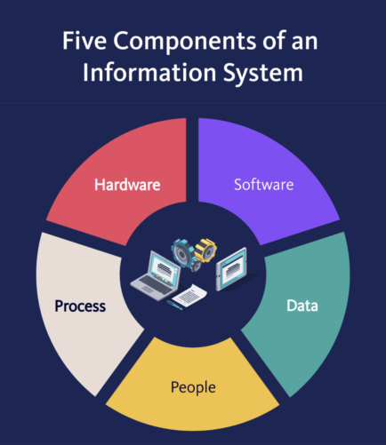
5 Components of an information System
Hardware
Software
Data
People
Process

Slide 26
Paper-based Information Systems
Card Indexes – paper-based
Separate systems
Separate files/programs for each application (payroll, personnel, accounts, ….)
Causes
Duplication
Inconsistency
Redundancy
Lack of integration and control
Notes:
Some issues of data management become clear when looking at card indexes

Slide 27
Paper-based Information Systems
Advantages?
Cheap; easy to use
Disadvantages?
No ‘ad hoc’ queries
No sharing
Large physical foot-print

Slide 28

Computer-based information systems
Database
“A shared collection of logically related data (and a description of this data), designed to meet the information needs of an organization.” (Connolly & Begg 2002)
Database management systems
Structured – Relation Databases
Non-structured – NoSQL
Graph database – Neo4j
Knowledge base – RDF,
Internet - Clouds
Notes:
Some issues of data management become clear when looking at card indexes

Slide 29

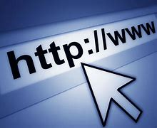

Internet-based Information System
Internet (Infrastructure):
Web: (Rules: http, HTML, Hyperlinks)
Clouds (Applications)

Slide 30
2' Activity
Think of an existing paper-based system that is loosely defined and it is not a Database.
Think of its current users/participants. Who are they?
Think of the extensions and implications if you deploy a relevant Database.

Slide 31
Challenges in IS
Searching and extracting information
Information Retrieval, keyword-based search engines, enterprise search
Human involvement necessary for browsing, retrieving, interpreting, combining
Maintaining information
Inconsistencies in terminology, outdated information
Need to store information in formal logical format
Appropriately designed databases and systems

Slide 32
Information system Development

Slide 33
Need for a Methodology
Extreme detail in design/specification
Stick with the requirements - Do not change them
In the computer industry, failures are covered up, ignored, and/or rationalized. As a result, we keep making the same mistakes over and over again
Keep a written report to document all causes of all successes and failures too!

Slide 34
Systems Development Life Cycle
Feasibility study
Purpose:
Meet organizational needs
Identify what went wrong/need
Identify what needs to be done
Identify the conditions
Set agreement
Systems Investigation
Systems Analysis
System Design
System Implementation
Review & Maintenance
Notes:
Systems analysis, requirements definition: Defines project goals into defined functions and operation of the intended application. Analyzes end-user information needs.
Systems design: Describes desired features and operations in detail, including screen layouts, business rules, process diagrams, pseudocode and other documentation.
Implementation: The real code is written here.
Maintenance: Changes, correction, additions, moves to a different computing platform and more. This is often the longest of the stages.

Slide 35
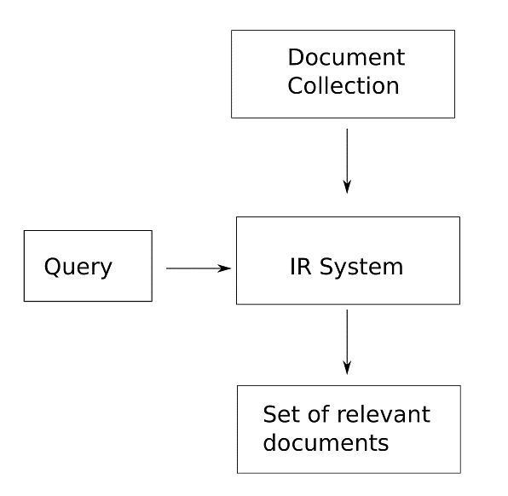
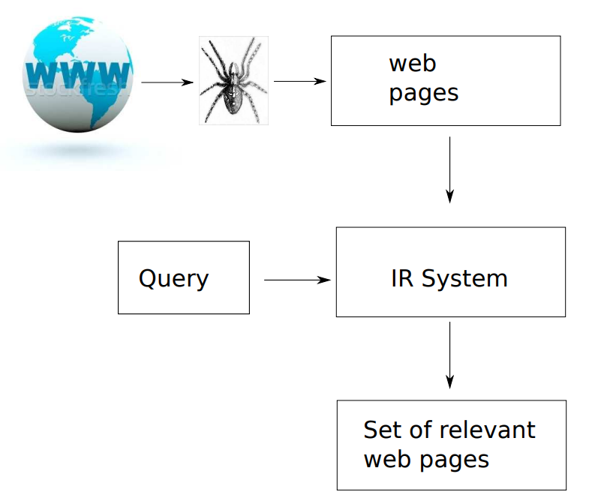
Information systems and Internet
General IS
Internet IS

Slide 36
Information systems and Internet
Question 1:
What is Internet?
What internet brings to us?
Question 2:
Considering an information system, what characters of Internet you can come up with?
Question 3:
What are the big problems you can think of about the internet in terms of information seeking/provision?

Slide 37
Information technology

Slide 38
Brief history of IT
1958
1958 article published in the Harvard Business Review; authors Harold J. Leavitt and Thomas L. Whisler commented that "the new technology does not yet have a single established name. We shall call it information technology (IT)."
Techniques for processing
The application of statistical and mathematical methods to decision-making
The simulation of higher-order thinking through computer programs.

Slide 39
Information technology
Computer Technology
Information technology (IT) is the use of computers to create, process, store, retrieve, and exchange all kinds of data and information
PC, Desktop, Workstation, Server, Middle range, Super-computer, HPC, mini, micro, single-board,
Network Technology
Information technology (IT) is the use of communication networks to share resources located geographically distributed locations. It includes physically wired, optical and wireless radio-frequency methods that may be arranged in variety of network topologies.

Slide 40
IT as a synonym for computers and computer networks
Based on the storage and processing technologies employed, it is possible to distinguish four distinct phases of IT development:
Pre-mechanical (3000 BC — 1450 AD)
Mechanical (1450—1840)
Electromechanical (1840—1940)
Electronic (1940 to present).

Slide 41

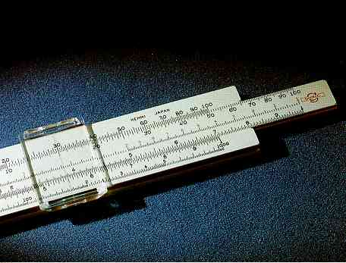
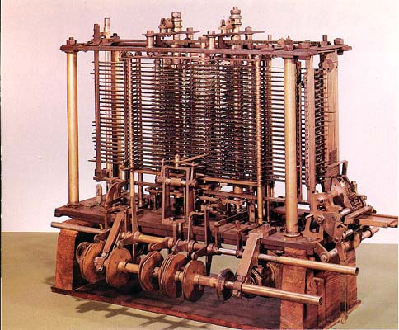
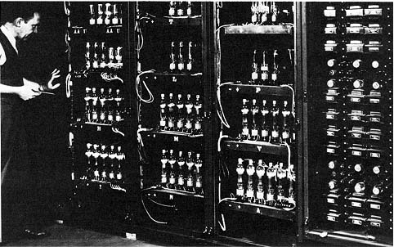
Historical pictures of Computers
The Abacus.
Slide Rules
The Analytical Engine.
ENIAC
Electronic Numerical Integrator and Computer

Slide 42
Networks
A networks is a collection of computers and related equipment connected using communications equipment so they can communicate with each other.
Local Area Networks (LAN) cover a small area such as a building
Wide Area Net works (WAN) cover a large area such as a city, region, country or several countries.

Slide 43
The Internet and World Wide Web
The Internet is a worldwide collection of interconnected networks
The World Wide Web (WWW) is a service on the Internet that links information stored on different computers
E-commerce. Business and individuals use Internet to promote and sell products and services
Social networking. Individuals using Internet to build personal networks with other users.

Slide 44
Web 2 and Web 3
Grid Computing. Using Internet to share resources (hardware)
Clouds. Sharing resources (software and hardware, platforms and infrastructures) without knowing their physical locations.
Web 2.0 is also called the participative social web. User-generated content widely shared in a virtual community.
Web 3.0. focus move to backend of data rather than frontend. Semantic and knowledge are the focal points. machine conception as opposed to human understanding.

Slide 45
5 New Information Technology Advances

Slide 46
5 New Information Technology
Artificial Intelligence
Cloud Computing
Machine Learning
The Internet of Things
Virtual Reality

Slide 47
Artificial Intelligence
Artificial intelligence (AI) uses advanced technology to mimic human thought processes. 3rd time lucky?
Examples of AI technology in use by consumers
driverless cars
facial recognition.
Expect in the coming years that AI will improve a wide range of applications, such as :
telecommunications
retail assistants
virtual assistants

Slide 48
Cloud Computing
Cloud computing refers to using servers on the Internet to store data instead of keeping this information on local servers or PCs.
-aaS. SaaS, PaaS, IaaS.
Move form local to Clouds
Consumer store their mail, photos and important files on the Internet for safekeeping.
Businesses have their applications residing on the cloud.

Slide 49
Machine Learning
machine learning is about building systems that can learn and improve based on the data they receive.
Applications of machine learning include:
product recommendations
email and malware filtering
search engine refinement
These technologies are all still in their nascent stage. But in the near future many expect them to be refined considerably. Today’s IT students should play a big role in this refinement.

Slide 50
The Internet of Things
The Internet of things (IoT) refers to embedding devices and appliances with the ability to communicate over the Internet.
smart home devices
wearables such as smartwatches
connected cars
a wide range of industrial equipment

Slide 51
Virtual Reality
Virtual reality (VR, AR and XR) entails simulating, producing and emerging a 3-dimensional environment that machine or human can interact with. It uses technology that includes:
viewing devices such as helmets and goggles
haptic-feedback devices such as gloves

Slide 52
Review
What is data, information, knowledge and wisdom?
How do they differ from each other?
Practically, what are the key components for a system build to manage them?
What are the key steps in systems development life cycle?
What are two current major ISs?
What are the top 5 advanced information technology?

